Slide 1
Review: Deep Implicit Statistical Shape Models for 3D Medical Image Delineation
Segmentation 팀장 신현호

Slide 2
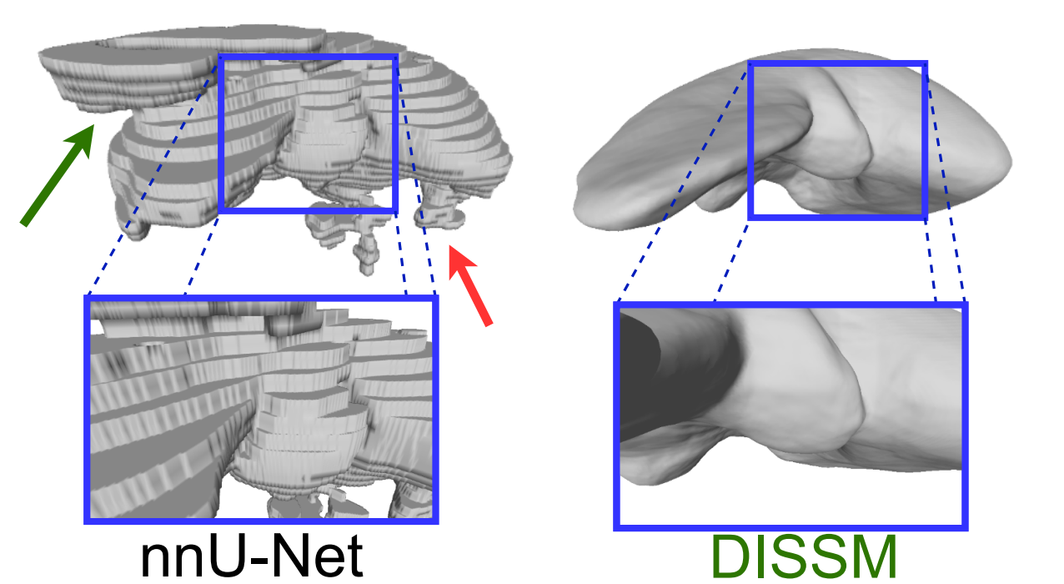
Preview: Conclusion
DISSM represents a new and promising approach to 3D medical imaging delineation!

Slide 3
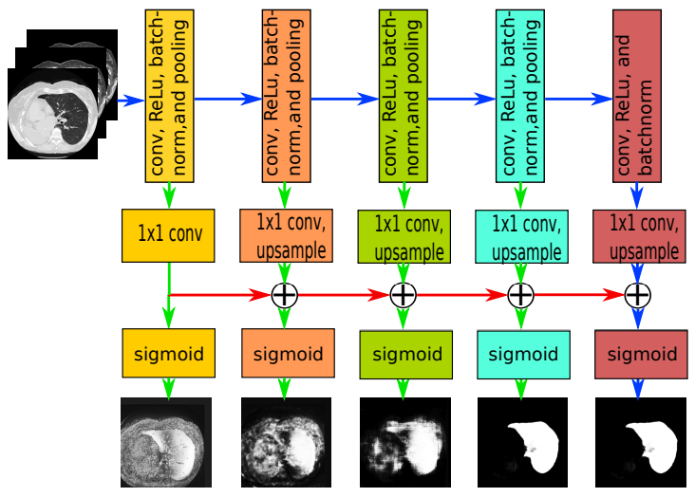
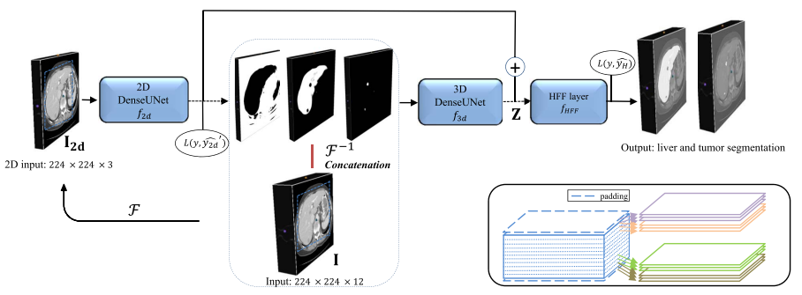
Recent History
Progressive Holistically-
Nested Network
P-HNN (2017)
Using 2D FCN backbone
H-DenseUNet (2018)
Cascade of 2D & 3D FCNs
nnU-Net (2021)
Using 3D FCN Cascade
Hybrid Densely Connected Unet

Slide 4
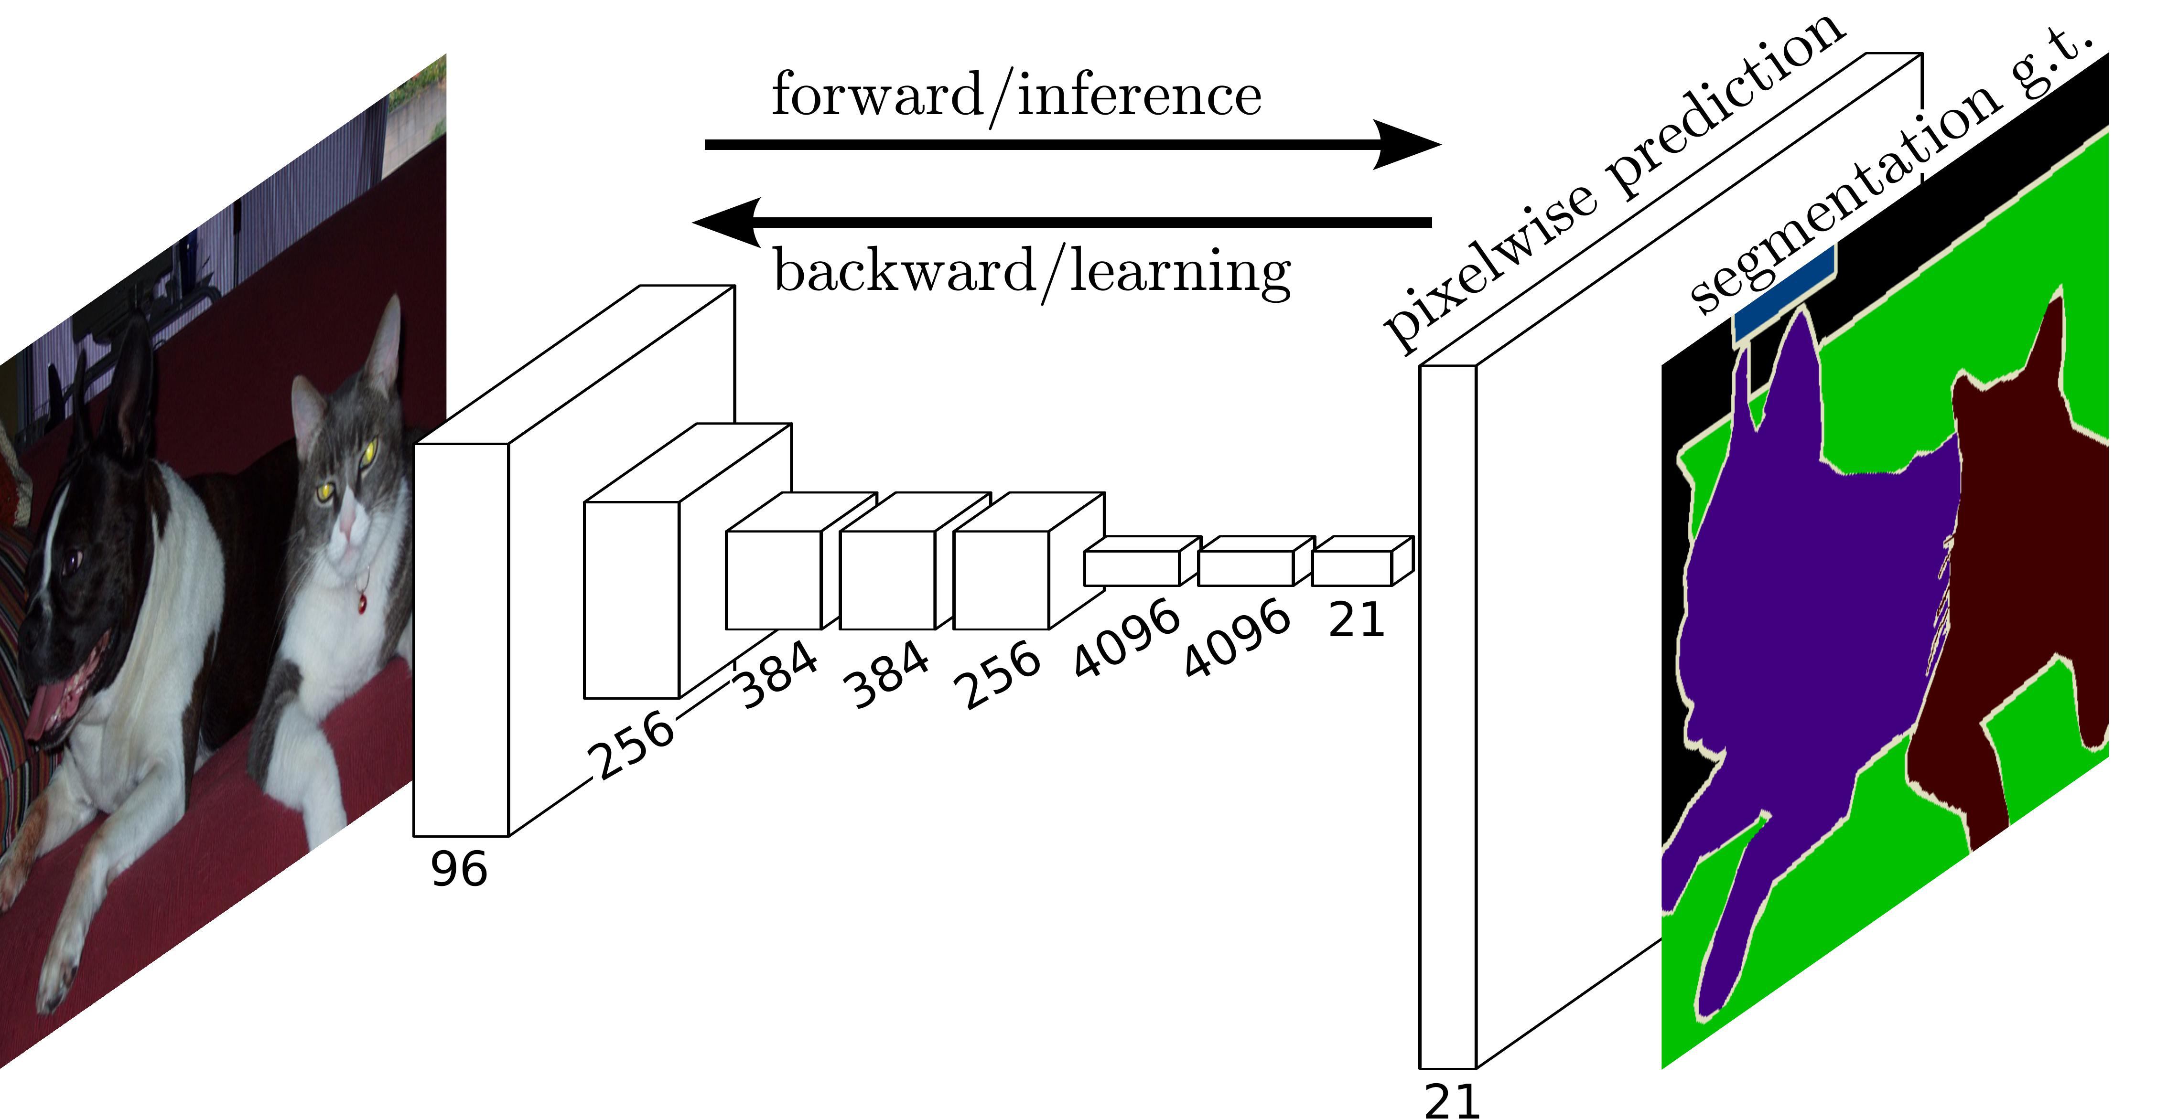
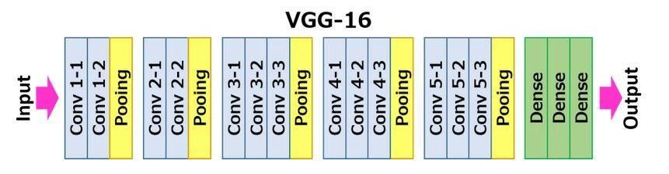
Fully Convolutional Networks for Semantic Segmentation
J. Long et al., 2014, Cited by 34892

Slide 5
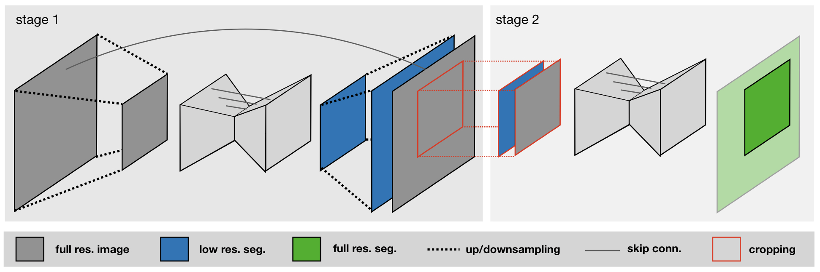
nnU-Net (no-new-U-Net)
automatically configures itself:
Preprocessing
Network Architecture[no-new]
Training
Post-processing
focused on pre- & post-processing
F. Isensee et al., 2021, Cited by 905

Slide 6

Beyond nnU-Net: MONAI Framework (*API)
Widely in use instead of nnU-Net(*project) // Customization & Optimization

Slide 7
nnU-Net (no-new-U-Net)
Limitations
Discretization (pixel: from continuous to discrete)
Low Quality (Low Resolution)
Cannot deal with other scenarios not seen in training

Slide 8
nnU-Net (no-new-U-Net)
TACE*
Treated
Lesion
Cardiac
Region
HOW?
*TACE: Transarterial chemoembolization

Slide 9
DISSM for 3D Medical Delineation
Deep Implicit Statistical Shape Model
Implicit Representation
Deep Learning
SSM [no-new]

Slide 10


Implicit Representation: Example
Microsoft Paint
GeoGebra
(dynamic mathematics software)

Slide 11
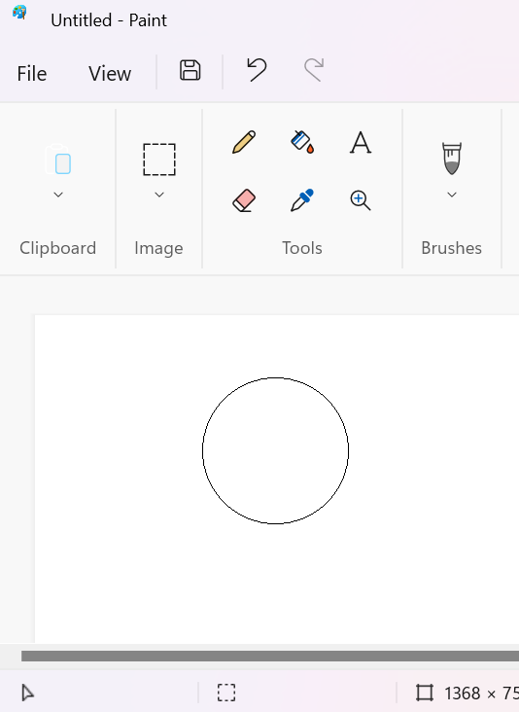
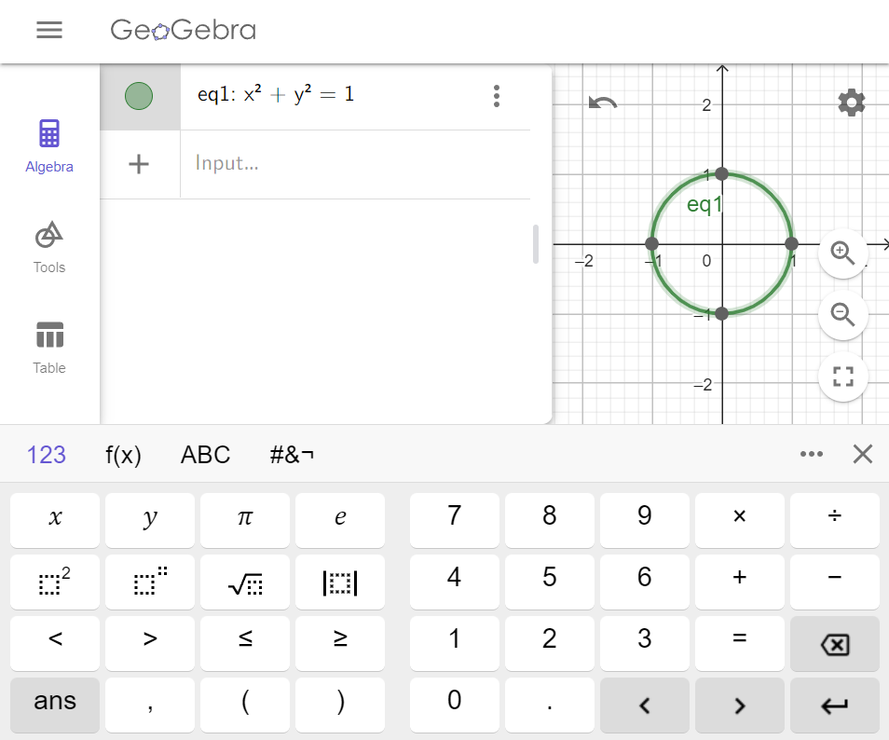
Explicit/Implicit Circle
Explicit Representation
Implicit Representation

Slide 12
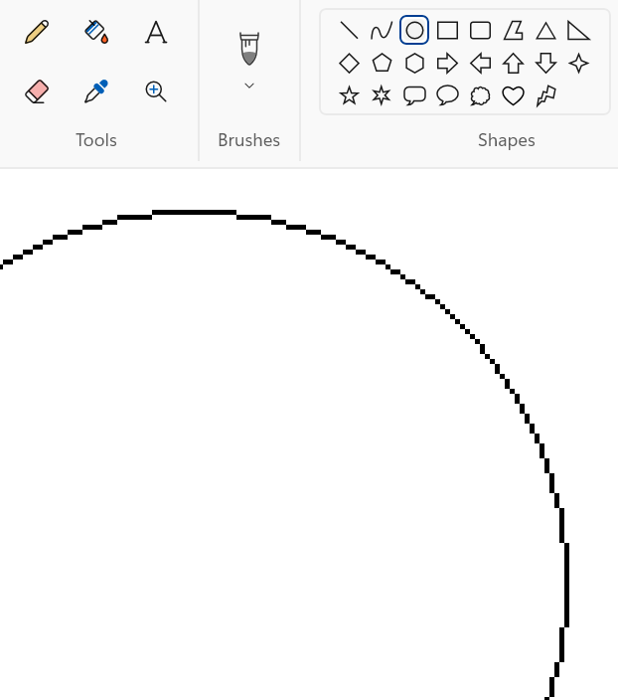
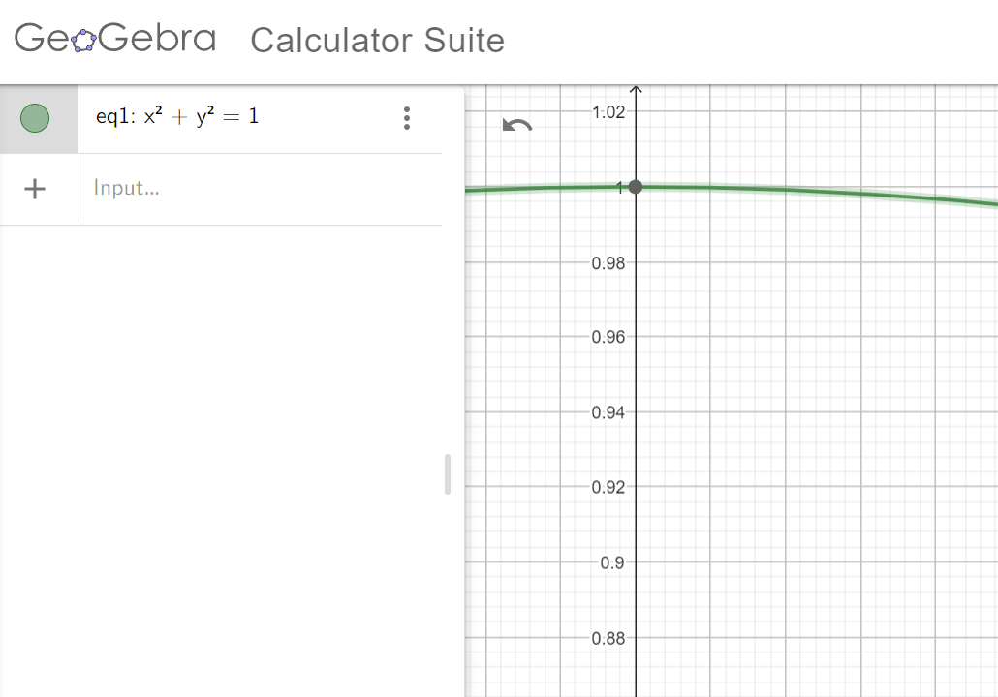
500% Zoom In
Explicit: Limited Resolution
Implicit: Infinite Resolution
1000%

Slide 13
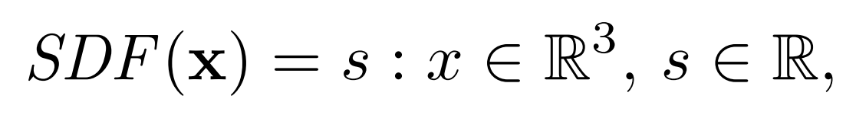
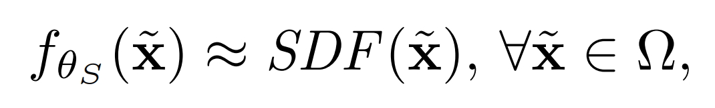
Signed Distance Function (SDF)
Deep MLP can be trained to approximate a shape’s SDF

Slide 14
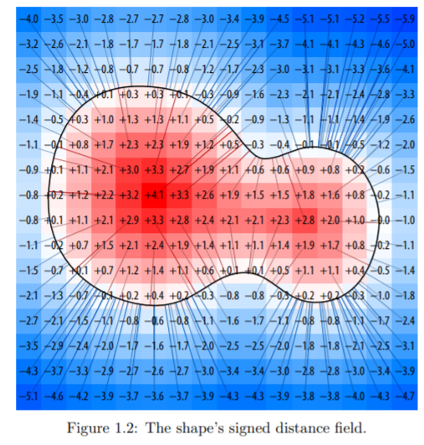
HOW?

Slide 15
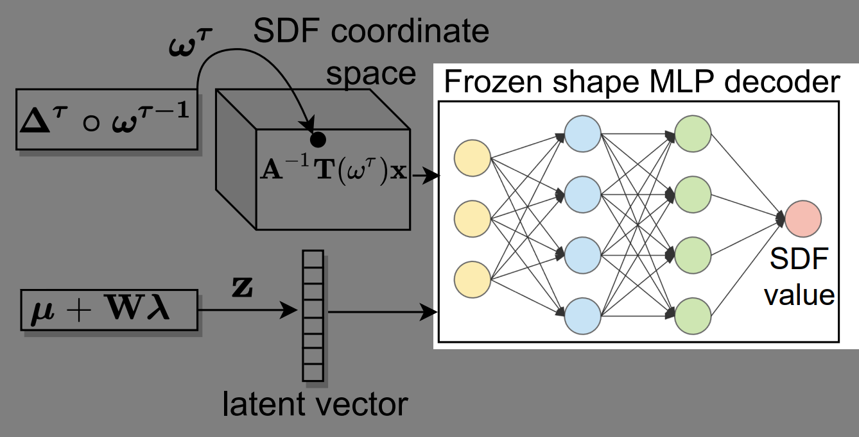
Shape Decoder (MLP) not FCN

Slide 16
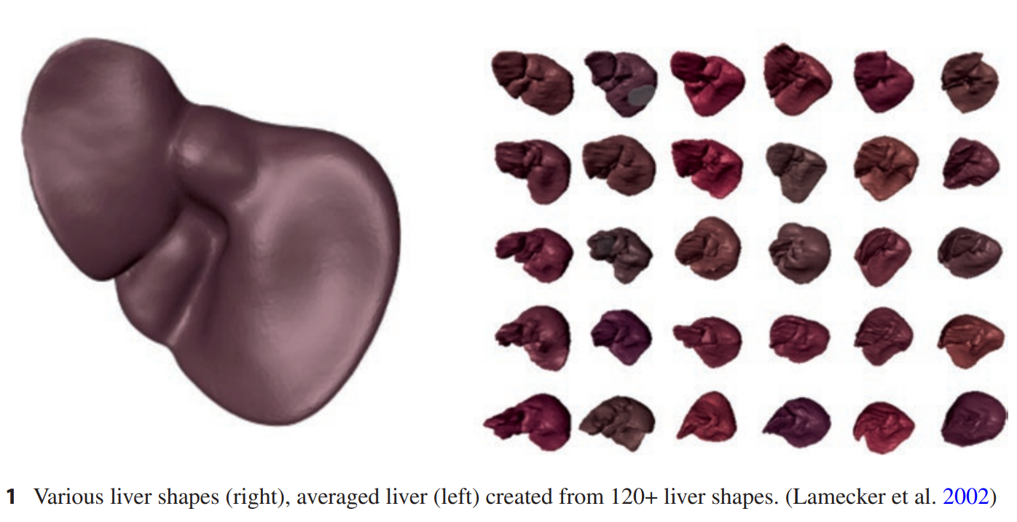
SSM (Statistical Shape Model)
Old concept in Statistical Anatomy
Geometric models describing semantically similar objects
Representing an average shape of 3D objects as well as their variation in shape
Average shape: Rigid pose
Variation: Non-rigid pose

Slide 17
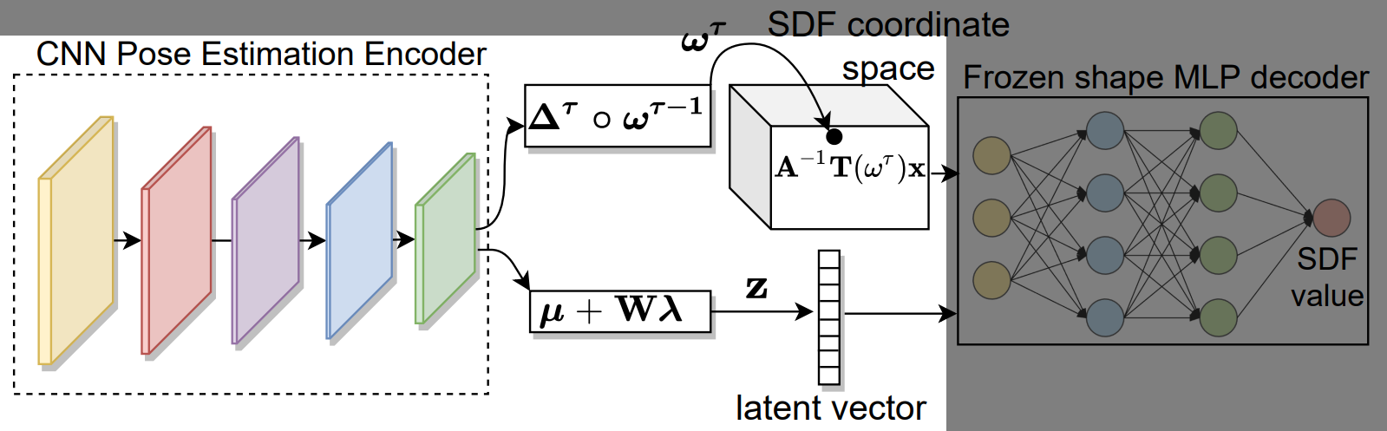
CNN Pose Estimation Encoder

Slide 18
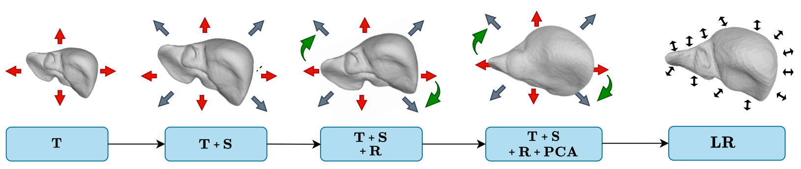
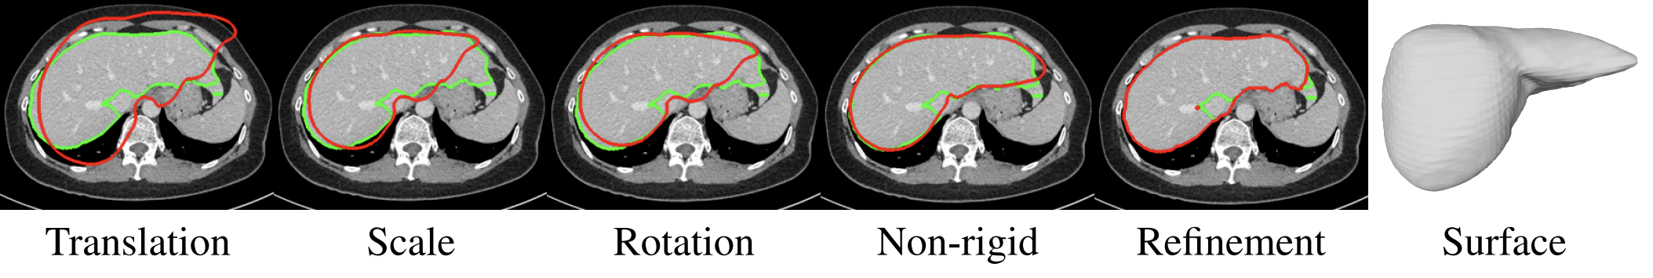
Pose Estimation Process
Rigid Pose
Non-rigid Pose
Red: prediction, Green: ground truth

Slide 19
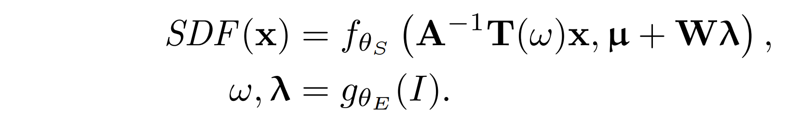
Encoder g_{θE}(I)
Encoder Input: Image // Decoder Output: SDF (not same)
[Decoder]
[Encoder]
how to scale, how to rotate, …
Encoder predicts ω (rigid pose parameters), λ (non-rigid PCA loadings)
Directly Predict? Too sensitive to Errors

Slide 20
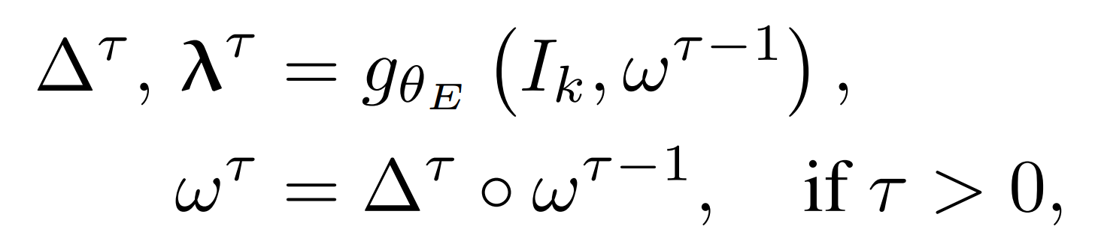
Markov Decision Process (MDP)
Popular in Reinforcement Learning
Initial pose: ω⁰
Current step: τ
Interpret the encoder as an “agent” that predicts corrections to the previous pose!

Slide 21
Experiment: Labeled Datasets
131 Liver CT Image (Simpson et al., 2019)
Train : Validation : Test = 7 : 2 : 1
97 Liver CT Image (Raju et al., 2020)
Test Only
142 Larynx CT Image

Slide 22
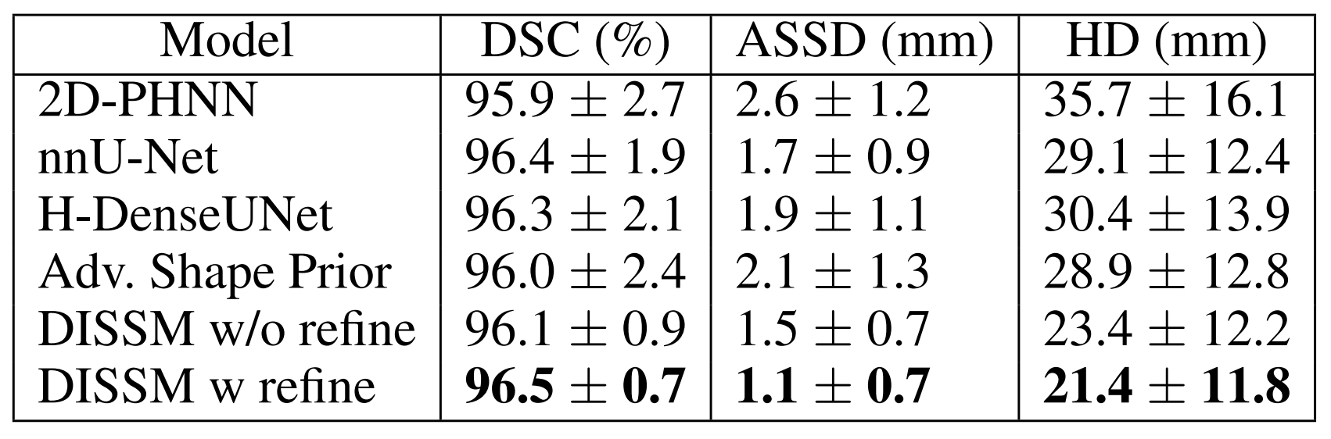
Results: Liver 1
DSC: Sørensen-Dice Coefficient (higher is better)
ASSD: average symmetric surface distance (shorter is better)
HD: Hausdorff distance (shorter is better)
‘F1 score’ in Image Segmentation
Table 2: Quantitative results on the MSD liver dataset.

Slide 23
Refinement
non-rigid pose estimation fails to capture very fine detail
Surface Refinement with FCN Model
Michalkiewicz et al., 2019

Slide 24
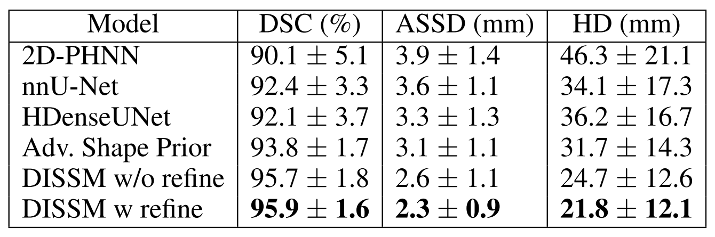
Results: Liver 2
Table 3: Cross-dataset results on the clinical liver dataset.

Slide 25
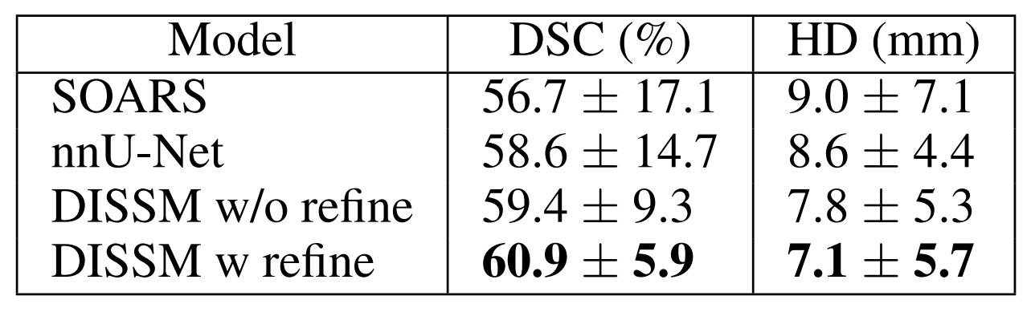
Results: Larynx
*SOARS: stratified Organ at Risk segmentation model (Guo et al., 2020)
Table 4: Larynx dataset results.

Slide 26
Conclusion: Author
DISSM directly outputs high-quality surfaces (NO voxelized masks)
DISSM outperforms leading FCNs
DISSM is a new and promising approach to 3D medical imaging delineation.

Slide 27
Drawbacks
DISSM relies on FCN (Surface Refinement)
Critical factor: ‘Implicit Representation’ or ‘SSM’
Alternative Network w/o Implicit Shape Decoder?

Slide 28
결론: 연구
Segmentation 분야 선행 연구가 상당히 많음 (cf: Recent History)
FCN, Unet, nnUNet에 대한 논문 리뷰도 필요
새로운 아이디어를 통해 기존에 없던 것을 창조해야 함
기존 모델과 비슷한 성능을 내는 것만으로는 부족함
논문의 저자는 FCN을 써서라도 기존 모델보다 명확히 뛰어난 모델 제시
outperforming model이 필요

Slide 29
결론: 연구
Segmentation 분야 선행 연구가 상당히 많음 (cf: Recent History)
FCN, Unet, nnUNet에 대한 논문 리뷰도 필요
새로운 아이디어를 통해 기존에 없던 새로운 시도를 해야 함
새로운 시도는 무에서 유를 창조하는 과정이 아님
이미 존재하는 개념과 도구를 적절히 조합, 활용해서 새로운 방법론 제시
선행 연구, 라이브러리, 프레임워크에 대한 이해 및 연습 필요
nnUNet의 사례를 볼 때, MONAI Framework의 중요성이 매우 클 것으로 전망됨

Slide 30
결론: 연구
기존 모델과 비슷한 성능을 내는 것만으로는 부족함
논문의 저자는 FCN을 써서라도 기존 모델보다 명확히 뛰어난 모델 제시
outperforming model이 필요

Slide 31
결론: 논문 작성
이론의 전개 순서가 반드시 process의 순서와 일치할 필요는 없음
[예시] 강조하고 싶은 부분을 앞으로, 취약한 부분을 뒤로 배치
논문의 저자는 취약한 Surface Refinement(FCN)를 가장 뒤로 배치
그 결과 Implicit Statistical Decoder가 가장 앞으로 이동

Slide 32
Thank You
감사합니다.

